Slide 1
Unit 1Welcome to New York
Lesson 12-13
Project “New York “
For the 9th form
Гудкова Ирина Алексеевна, учитель английского языка
МБОУ «АСОШ №2» п.Адамовка.

Slide 2
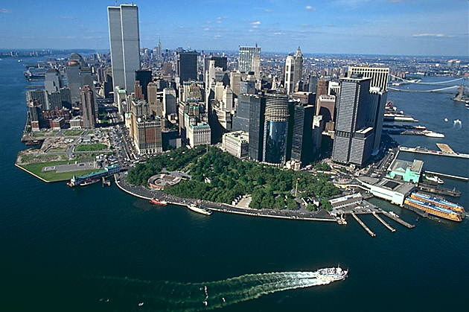
Sights of New York
«I want to wake up in a city that never sleeps and find I'm a number one, top of the list.»

Slide 3
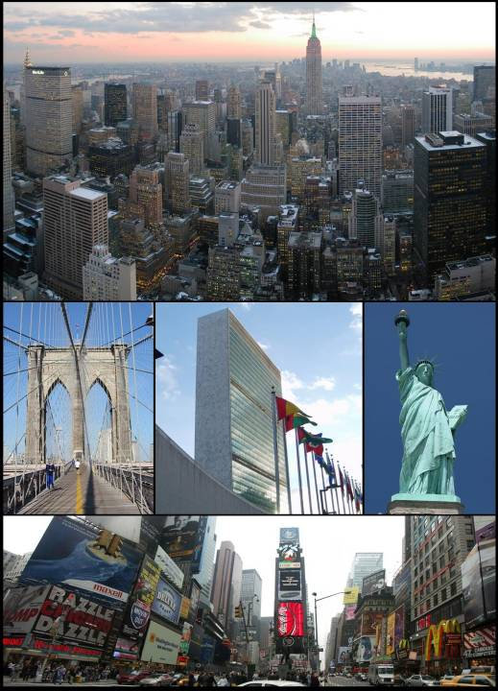
New York
New York is one of the largest cities in the country, but it is not the capital.
New York is in the state of New York.
New York is America`s Big Apple.

Slide 4
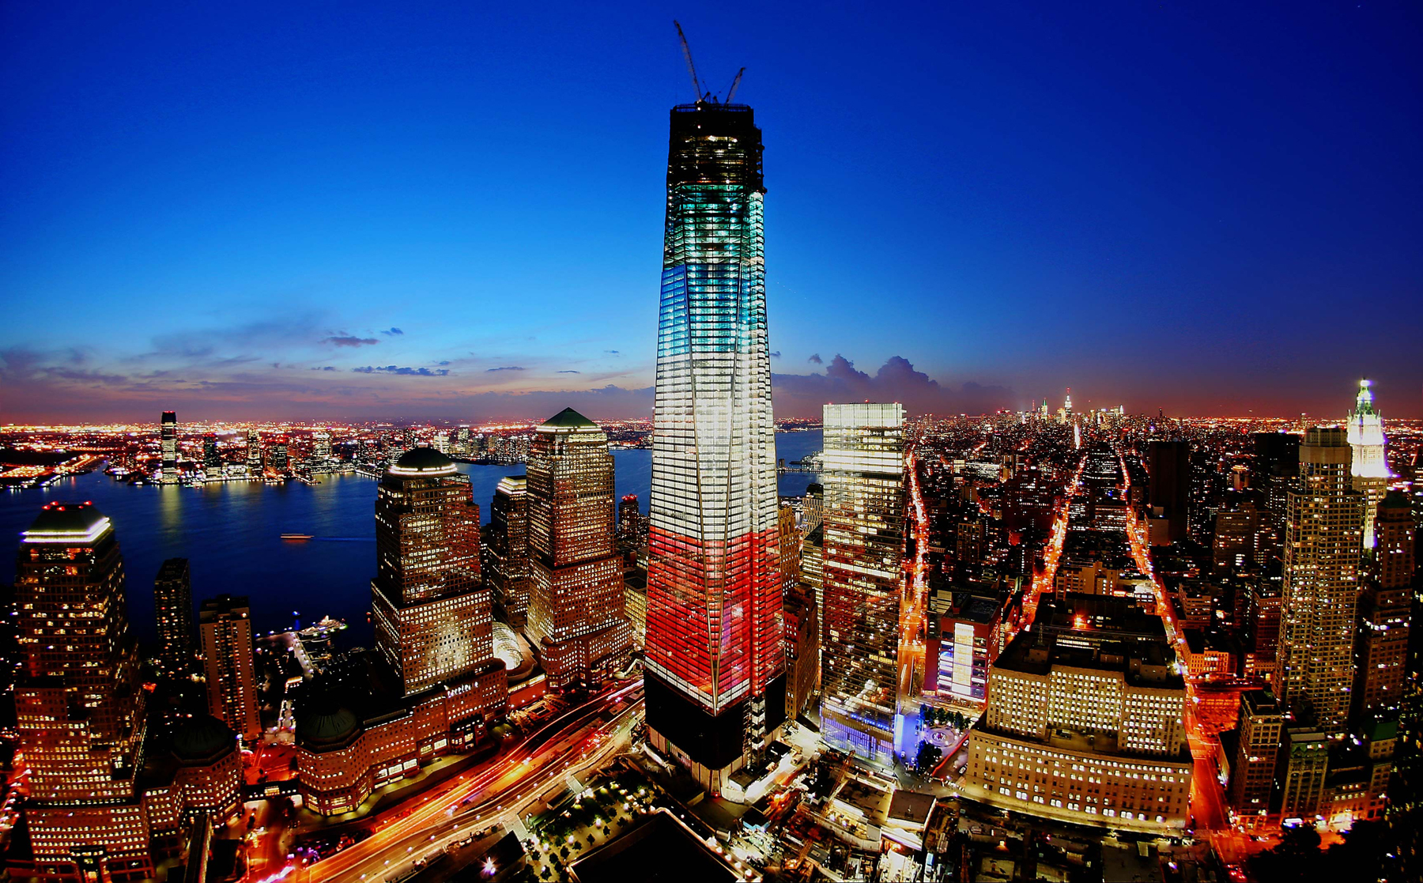
Another name for New York is Big Apple. ” There are many apples on the tree. But only one Big Apple.”
Rebuilding Plans

Slide 5
Repeat the words
A masterpiece
Manhatten
Brooklyn
Queens
Staten Island
The Bronx
The Hudson
Сеntral Park
A skyscraper
The Empire State Building
The Rockefeller Center
The Guggenheim Museum
A borough
Broadway
The Twin Towers
The Statue of Liberty

Slide 6
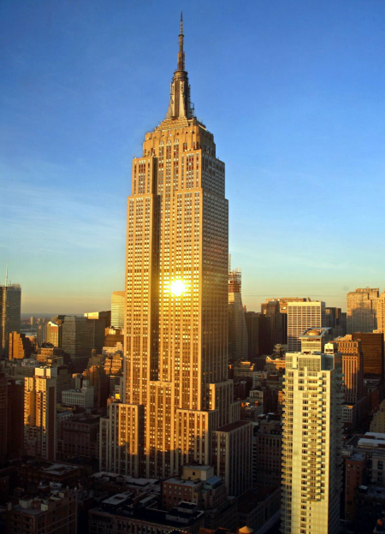
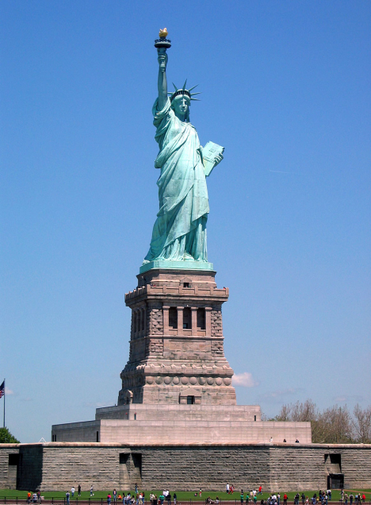
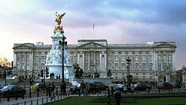
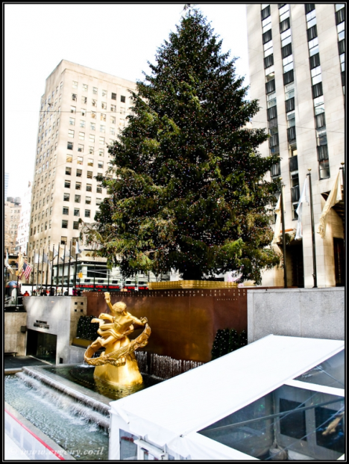
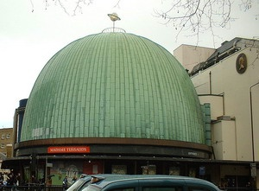
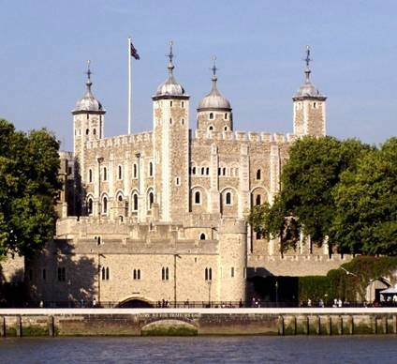
What sights are in New York?

Slide 7
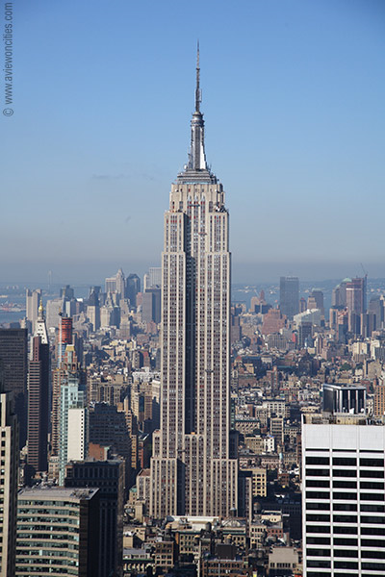
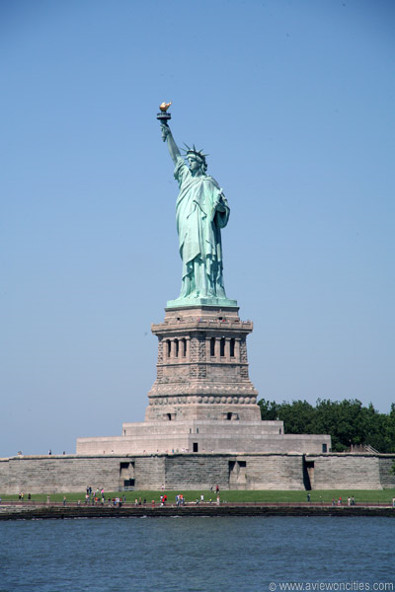
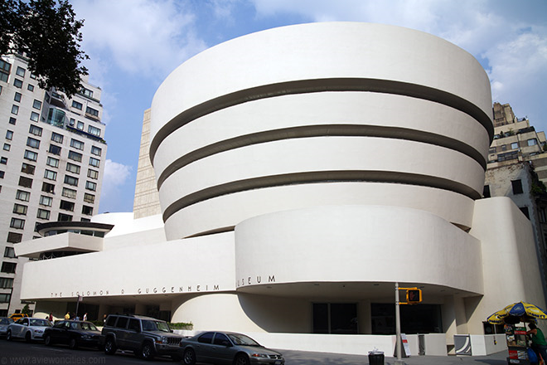
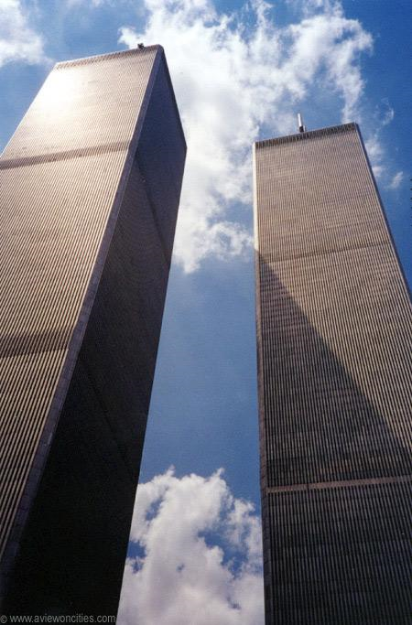
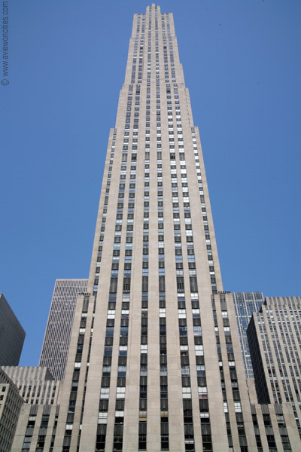
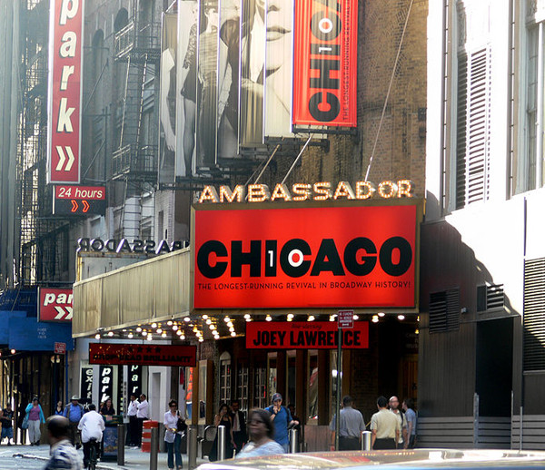
New York City
2
1
3
4
5
6
The Guggenheim Museum
Broadway
The Empire State Building
The Rockefeller Center
The World Trade Center
The Statue of Liberty

Slide 8
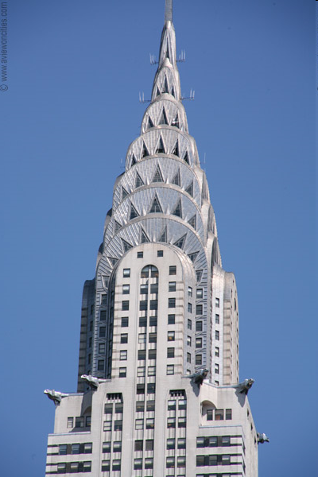
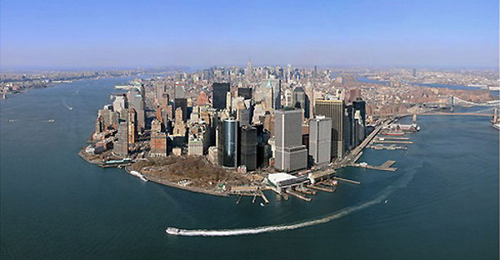
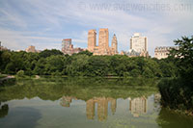
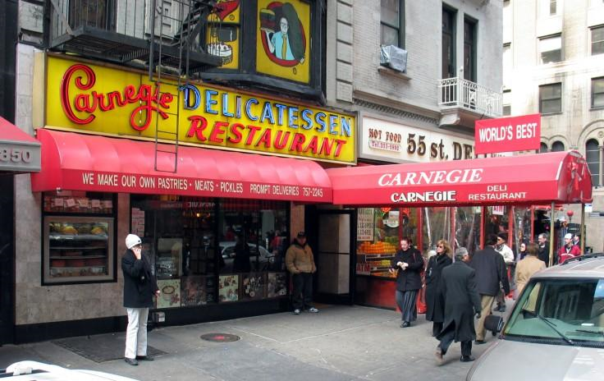
New York City
1
2
4
3
Manhattan
Central Park
The Chrysler Building
The Carnegie Deli Restaurant

Slide 9
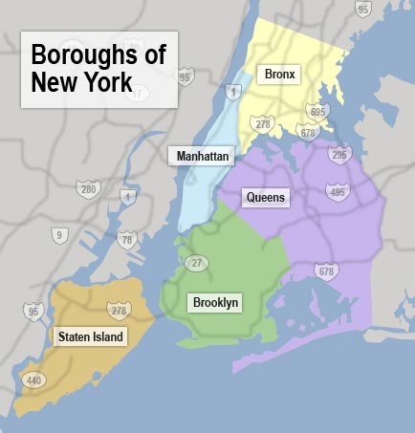
New York City
How many boroughs are there in New York. What are they?

Slide 10
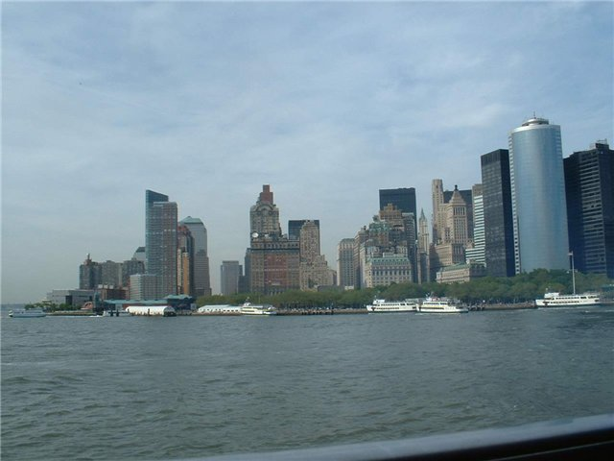
The Hudson
Where is New York situated?

Slide 11
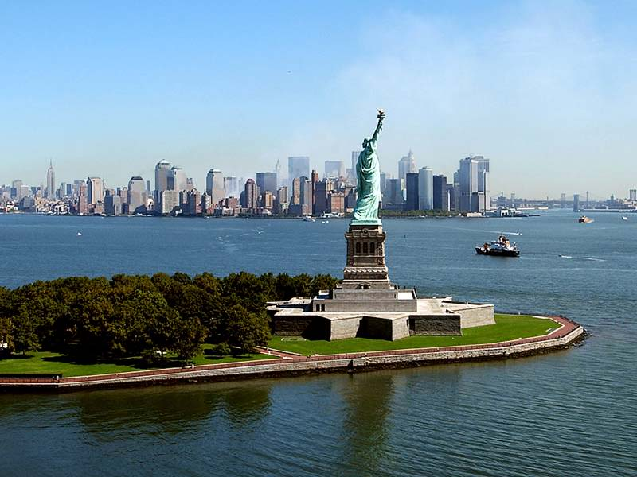
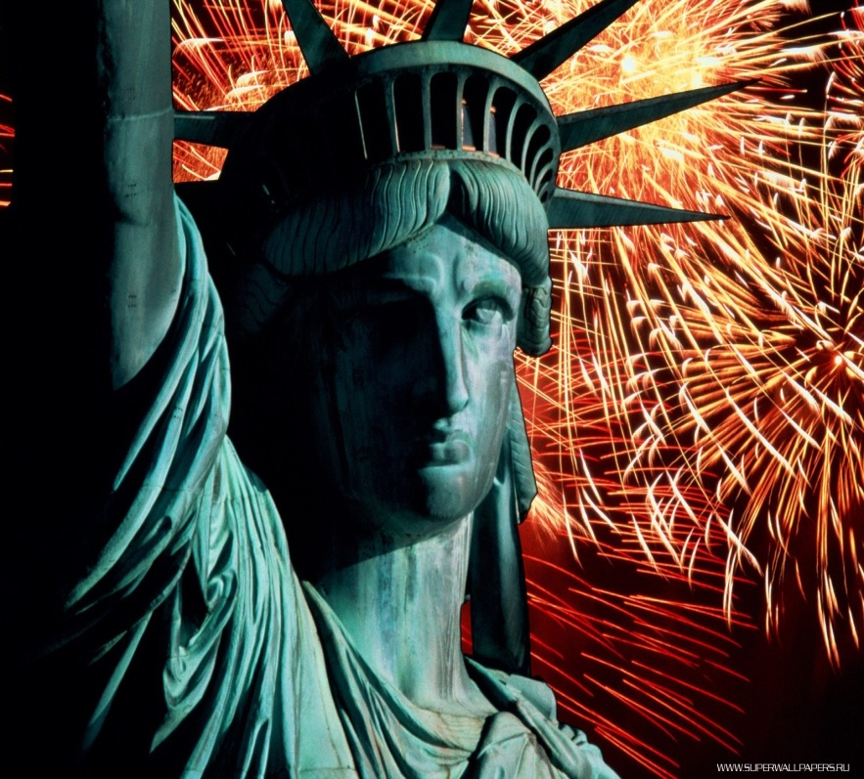
The Statue of Liberty
The Statue of Liberty is the most famous symbols of America. The millions of immigrants who had to come to America by sea were welcomed by a very tall woman
What is the most famous symbol of America?
How can you see the Statue of Liberty?

Slide 12
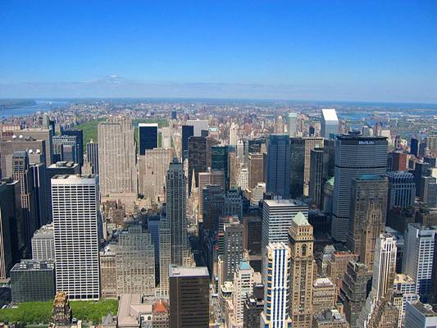
Manhattan is the heart of the city.

Slide 13
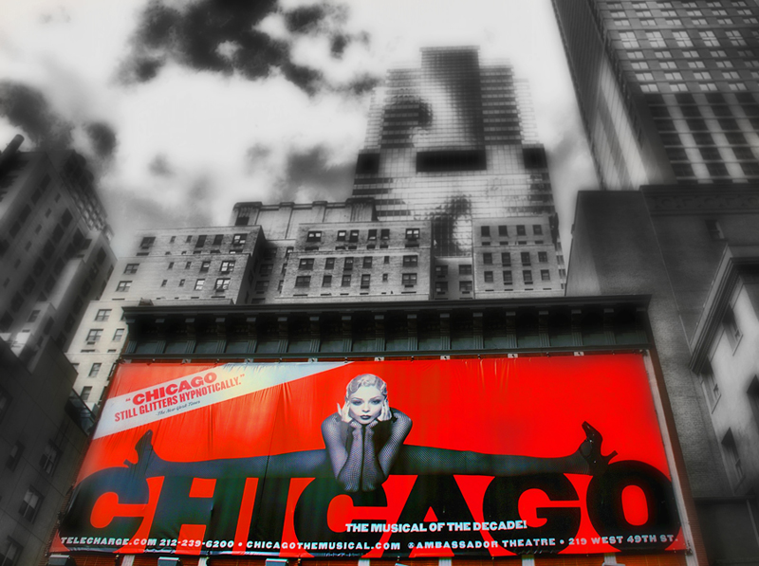
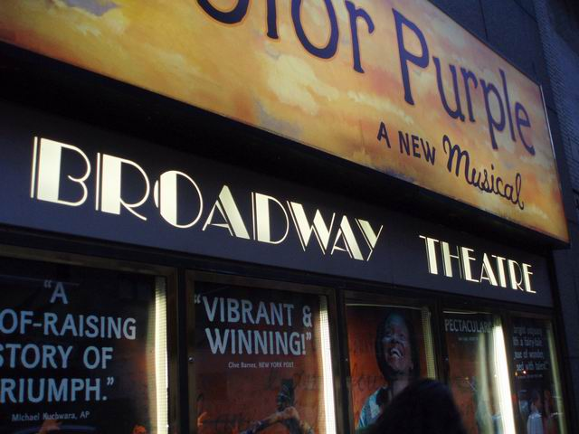
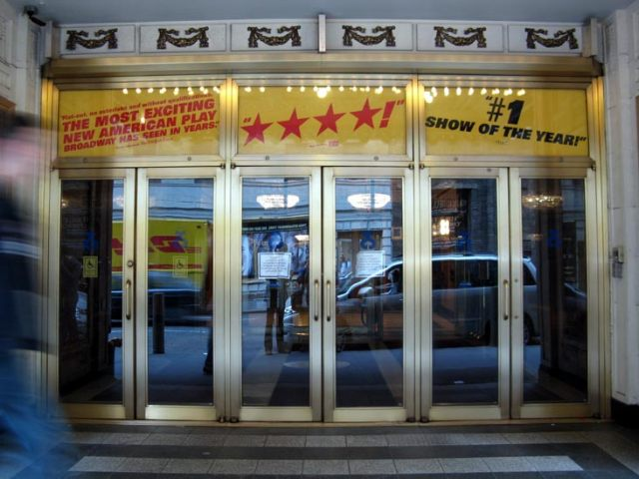
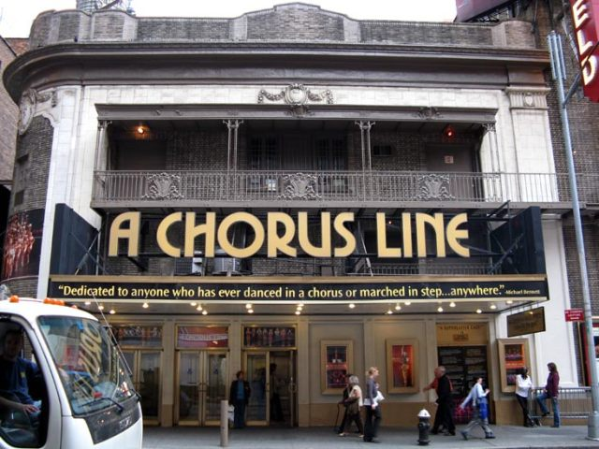
Broadway

Slide 14
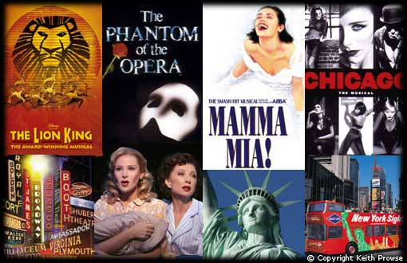
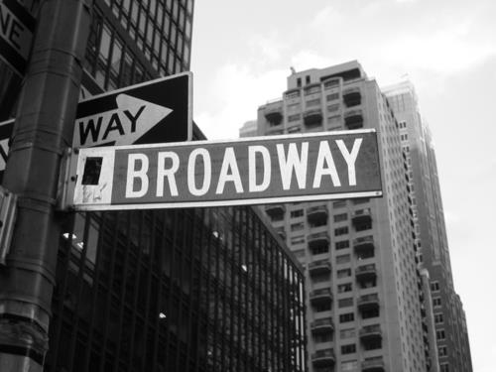
Those who are interested in theatre will be able to enjoy different musicals on Broadway.

Slide 15
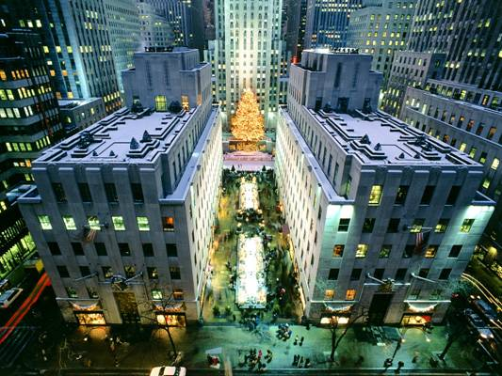
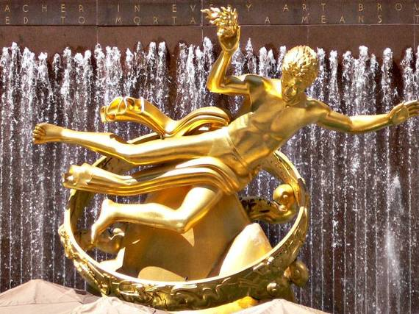
The Rockefeller Center.
Its Christmas Trees are
the largest and most
beautiful in New York.

Slide 16
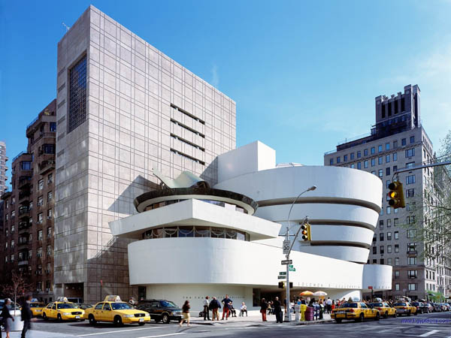
Even if you are not interested in modern art, you shouldn’t miss a chance to visit one of the world’s most extravagant museums. The Solomon R. Guggenheim Museum.

Slide 17
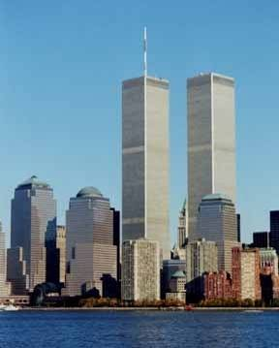
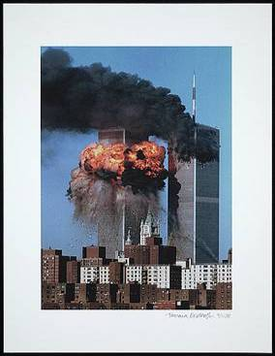
The Twin Towers
The Twin Towers of the World Trade Center used to be higher until September 11.2001.
It was destroyed by terrorists.

Slide 18
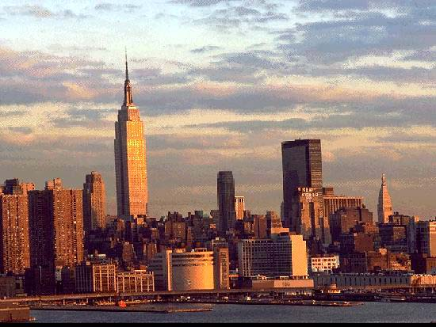
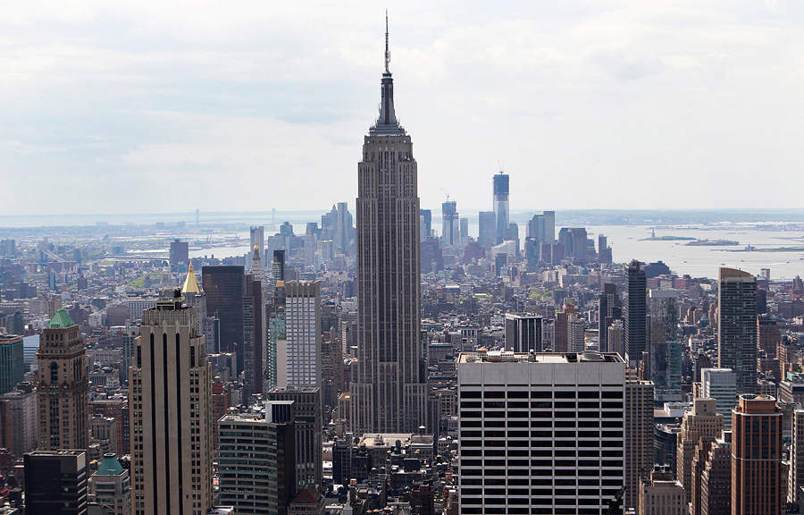
The Empire State Building
The Empire State
Building is the
tallest skyscraper
in New York.

Slide 19
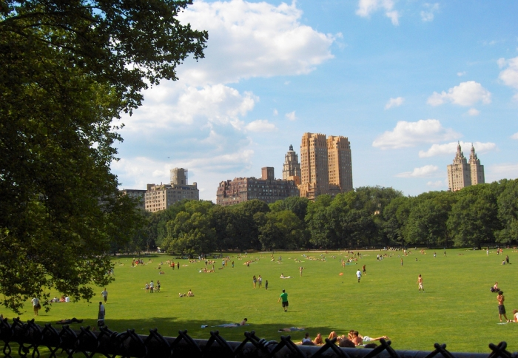
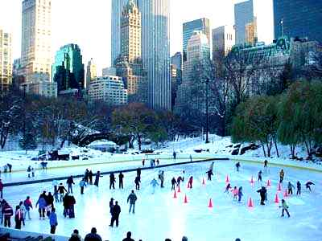
Central Park
Type Urban park Location Manhattan in New York City, New York Coordinates
Area 843 acres (341 ha)
Created 1857
Operated by Central Park Conservancy
Visitors about 37.5 million annually
Status Open all year
Architect: Frederick Law Olmsted, Calvert Vaux

Slide 20
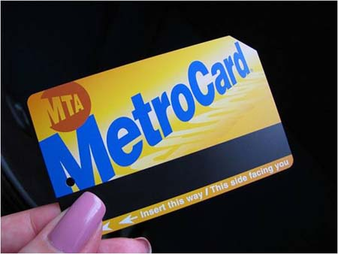
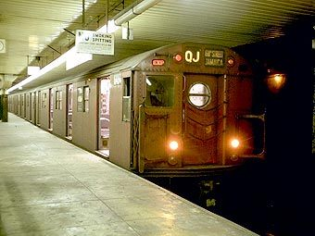
New York subway

Slide 21
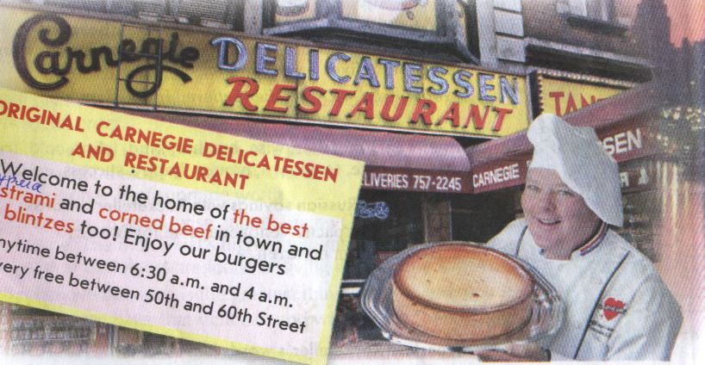
THE CARNEGIE DELI
Pastrami – бастурма
Corned beef – солёная говядина
Blintzes – блинчики
Homemade chicken soup – домашний куриный суп

Slide 22
Answer the questions
Where is New York situated?
How many boroughs are there in New York. What are they?
What is the city famous for?
What is the most famous symbol of America?
How can you see the Statue of Liberty?
What is the highest building in New York?
When did it become the tallest building?
What happened in September 2001?
What is the cheapest and fastest way to see New York?
Who build Rockefeller Center?
What kind of restaurant is Carnegie Deli?
Can you try Russian food there?

Slide 23
Use the words and expressions
The most fascinating part of the city is…
The most interesting building is …
The most amazing place is…
I was greatly impressed by….
I think it’s worth visiting…
Don’t waste your time on…
It’s not worth visiting….
In my opinion it’s
I’d like to see
I’d like to visit

Slide 24
New York Quiz
1.The city of New York is made up of ______ boroughs?
a)seven
b)five
c)four
2.The largest art museum in the Western Hemisphere is located in NYC, what is its name?
a)Metropolitan Museum of Art
b)Solomon R. Guggenheim Museum
c)Museum of Modern Art
3.One of the great bridges into Manhattan was designed by John Roebling with Gothic arches, and opened in 1883, it is the ________________?
a)Manhattan Bridge
b)Brooklyn Bridge
c)George Washington Bridge
4. If you want to see a famous musical you should go to …
a)Fifth Avenue
b)Chicago
c)Broadway

Slide 25
5.Who designed the Guggenheim Museum?
a) Frank Lloyd Wright
b) Oliver Cromwell
c)John D. Rockefeller
6.What is Broadway famous for?
a)cinemas
b)theatres
c)shopping centers
7.The Statue of Liberty used to
a)welcome the presidents of the USA
b)show the way to the ships
c)welcome immigrants to the USA
8. Where is New York situated?
a)on the River Thames
b)on the River Hudson
c)on the Potomac River
9. What is Rockefeller Center Famous for?
a) beautiful statues
b) Christmas trees
c) famous theatres
10.What is the nickname of New York City?
a)American Pie
b)Big Ben
c)Big Apple

Slide 26
11.Manhattan's East and West Sides are primarily divided by which street?
a)Fifth Avenue
b)Drive Park Avenue
c)42nd Street
12.Which of these bridges connects Manhattan with Queens?
a)Third Avenue Bridge
b)59th Street Bridge
c)Madison Avenue Bridge
13.When was the World Trade Center in New York attacked and destroyed?
a)11 September 2001
b)11 November 2001
c)9 November 2001
14.New York’s financial centre is…
a)Wall Street
b)Broadway
c)Madison Avenue
15. Name the famous New York City building whose construction was completed in 1931.
a)World Trade Center
b)Rockefeller Center
c)Empire State Building

Slide 27
Answers
1. b)Five. The boroughs are: Staten Island, the Bronx, Queens, Brooklyn and Manhattan.
2.a)Metropolitan Museum of Art.
3. b)The Brooklyn Bridge.
4.c)Broadway
5.a) Frank Lloyd Wright
6.b)theatres
7.c)welcome immigrants to the USA
8.b)on the River Hudson
9.b) Christmas trees
10.c)Big Apple
11.a)Fifth Avenue.
12.b)The 59th Street Bridge.
13. a)11 September 2001.
14. a)Wall Street.
15. c)The Empire State Building.

Slide 28
Your results
No mistakes - «Excellent»
1-2 mistakes - «Very good»
3-4 mistakes - «Good»
5 -7 mistakes - « Satisfactory»
More than 7 mistakes - « Try again»

Slide 29
Homework
At home you’ll write a composition
“The most interesting sight in New York”.

Slide 30
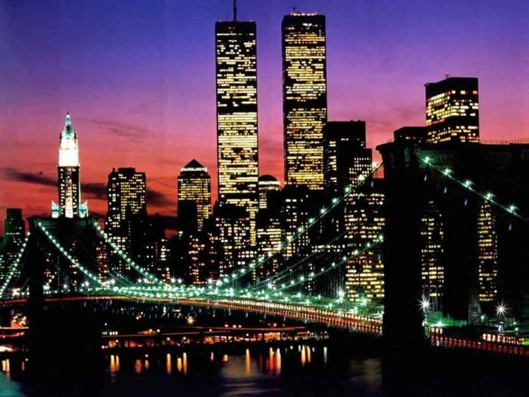
WELCOME! WELCOME! WELCOME!
New York is waiting for you

Slide 31
Использованные ресурсы
www.newyork-info.ru
http://www.mynyc.ru/skyscrapers/ny.brooklyn.ru/photo/
www.americatravel.ru
http://about.brooklyn.ru/
www.ny-city.ru
http://www.sotovik.ru/news/news_14208.html
http://www.newyork-info.ru/news/2009/5/21/id_368.html p://www.liveinternet.ru/users/krasnobay/post107011418/
http://www.webturizm.ru/news/news.php?id=9801
p://www.ami-tass.ru/article/11464/6
http://www.newyork-info.ru/news/2009/5/21/id_368.html
http://lilokkimi.beon.ru/4.html
http://www.sotovik.ru/news/news_14208.html
http://www.newsland.ru/index/news/cat/48/ord/36/tag/0/page/279/
www.photodan.org/comments_all.php?page=609
http://centl.ru/?p=15063
http://nyc.com.ua/new-york/10-novaja-istorija.html
http://www.bgfactor.org/index_.php?cm=3&id=8332
http://www.bankoboev.ru/oboi_rozhdestvo_u_centra_rokfellera.c.htm
http://www.arttrans.com.ua/sub/artists/list33.html
http://hiero.ru/Siylook?category=photo
http://olga2901l.narod.ru/art.html
http://www.spletnik.ru/blogs/kruto/5255_muzei_mira
http://mysmiles.ru/index-20.php&usg
http://office.microsoft.com/ru-ru/training/CR010065457.aspx
http://www.orangesmile.com/destinations/new-york/index.htm
http://aeterna.qip.ru/test/view/68525/
http://www.ourgames.ru/igra/Za-pokupkami-v-Niu-Iork.html?campaignmedium=casualpromo&campaignelement=thumb2&campaignname=gamepromotion
http://www.tourister.ru/world/america/united-states/city/new_york_city
http://aeterna.qip.ru/tests/cat/%D0%BD%D1%8C%D1%8E-%D0%B9%D0%BE%D1%80%D0%BA/

